Slide 1
2021 Ski Resort Study
Big Mountain Resort ticket price analysis

Slide 2
Problem
Big Mountain recently installed a new chair lift that will cost over 1 million in expenses each year and they want to raise their prices to combat the new operating cost
Big Mountain is looking to increase the price of entry

Slide 3
Solution
Add an additional run and increase the vertical drop by 150 feet with the new chair lift that is already installed.
Board plan: Scenario 2

Slide 4
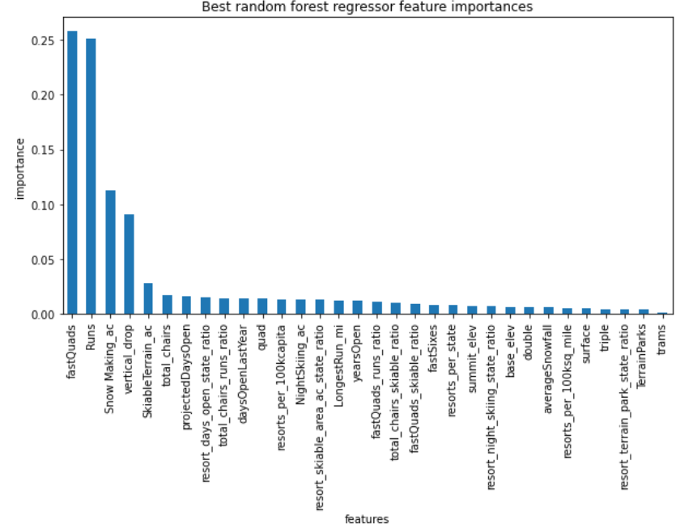
Modeling Results

Slide 5
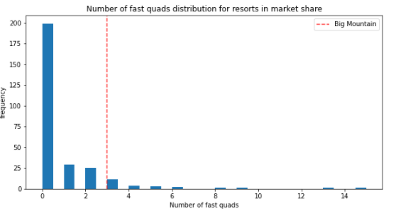
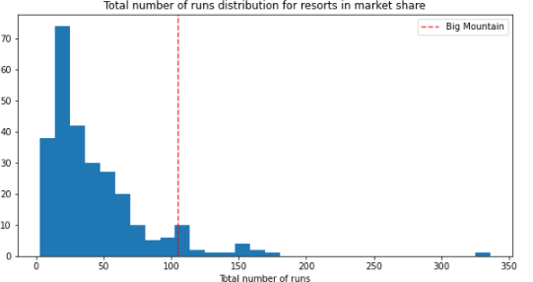
Quads and Runs

Slide 6
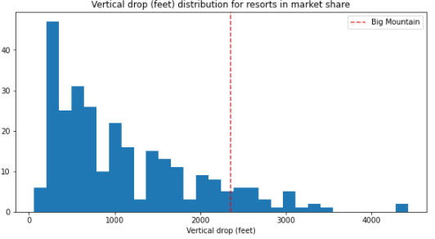
Vertical Drop

Slide 7
Scenario Deep Dive
Scenario 1
Scenario 2
Scenario 3
Close down runs to reduce operating cost
From our model there was a direct correlation between closing down runs and lower admission cost
Add a run and increase vertical drop by 150 feet
From our graph from earlier we can tell that the increasing the number of runs has a very strong correlation when compared to ticket price
Scenario 2 but with an additional snow making equipment
Snow making equipment does not rank highly and showed almost no increase in price from scenario 2

Slide 8
Impact
max growth
Scenario 2 would increase our predicted ticket price by $2 which equates to $3,474,638 over the course of the season, this will also offset the $1,000,000 concern of the already implemented ski lift

Slide 9
Further Findings
From our price analysis we concluded that the fair market value of Big Mountain Resort tickets should be $95 when current prices are $81. This is without any additional adjustments from scenario 2. While we would suggest being conservative in the price increase their is strong evidence that Big Mountain Resort has room to increase price with no additional features.

